Slide 1








09L 13L 17L 21L 00L
ISOLD
Blowing Dust
Weather: 19 April 11
24Hr
RAIN
SKYCONDITION | TODAY’S STATS | WINDS | ILLUMINATION
Partly Cloudy | LOW: 55F/13C HIGH: 84F/29C April AVG HIGH: 81 ºF LOW: 55 ºF | N W E S | SUNSET: 17/1939L EENT: 17/2037L MOONRISE: 17/1251L MOONSET: 18/0257L BMNT: 18/0534L SUNRISE: 18/0631L ILLUM: 52% 62%
 |  | W-NW 8-12 G18 KTS
1.5”
1.25”
1”
.01”
T
.75”
.50”
.25”
ISOLD TS & WIND GUSTS TO 25KTS BL DUST / HAZE
VISIBILITY (Mi)
.25
.50
.75
1
2
3
4
5
6
7+
DUST / HAZE
ILLUM DATA
17/0000L 52%
17/2359L 62%
17 Apr 05 NVG (Green)
SMOKE
18L 21L 00L 03L 06L
PERSONNEL
HELO OPS
HELL FIRE
CONVOY OPS
FOG/MIST
ISOLD TSTM
GUSTS 25-28 kts
UNCLASSIFIED

Slide 2
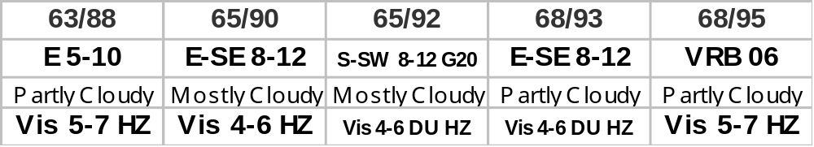
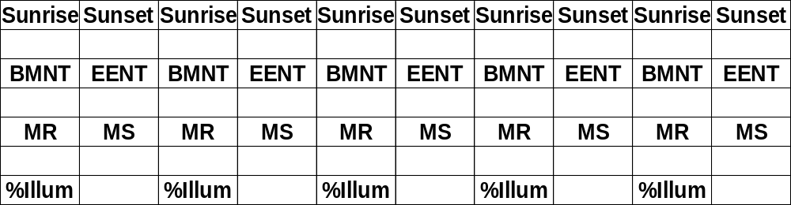
DUST
BLDU
ISOLD
VCNTY
FOG
SMOKE
HAZE
Weather Outlook
ISOLD
ISOLD TS & BLDU
VCNTY
TSTMS
AM FOG
TSTMS VCNTY
ISOLD TSTMS
ISOLD
ISOLDTSTMS
TEMP
WIND
VCNTY TSTMS
ISOLD BLDU VIS to 3200m
ISOLD BLDU
WX VIS
AREAS CIG & VIS
ISOLD CIG & VIS w/ SHRA/BR
PERSONNEL
HELO OPS
HELL FIRE
CONVOY OPS
WIND GUSTS
WIND GUSTS & TSTMS VCNTY
0631 1940 0630 1941 0628 1942 0627 1943 0626 1943
BL DUST
BLDU VIS to 1600m
0534 2038 0532 2038 0531 2039 0530 2040 0528 2041
DUST HAZE
ISOLD FOG
1350 0332 1450 0403 1549 0430 1649 0455 1749 0520
71% 79% 86% 93% 97%
UNCLASSIFIED

Slide 3


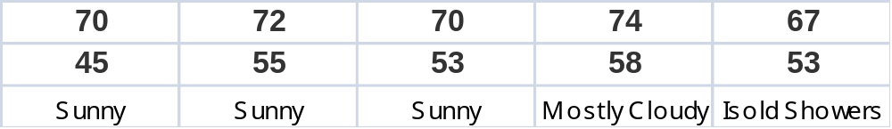
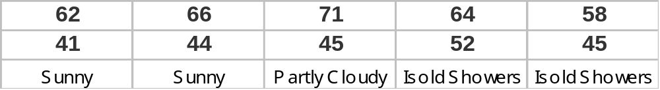
HAZE
ISOLD
FOG
FRZNG PRCP
VA AREA FORECAST
MIXED
ISOLD
HIGH
LOW
WX
MD AREA FORECAST
HIGH
LOW
WX

